Slide 1
Designing a Talend standard Job
February 16, 2018
Presenter:

Slide 2
What is a job design?

Slide 3
What is Talend Job?
A Job Design is the runnable layer of a business model. It is a graphical design, of one or more components connected together, that allows you to set up and run dataflow management processes

Slide 4
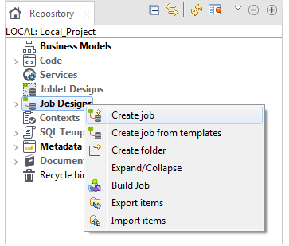
How to create Job?

Slide 5
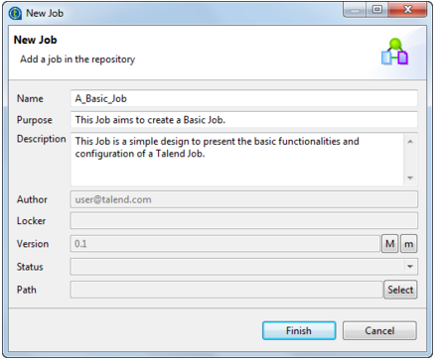
How to create a Job?
Fill the Job properties as shown in the screenshot.

Slide 6
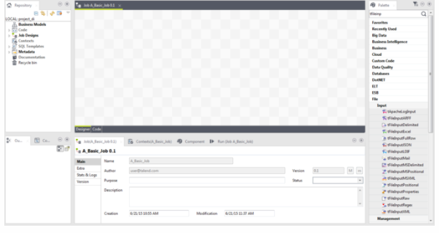
Design a Talend Job
The Job you created is now listed under the Job Designs node in the Repository tree view

Slide 7
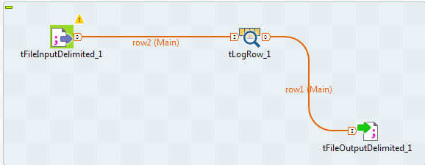
Link different Components
Right-click the source component
In the contextual menu that opens, select the type of connection you want to use to link the components, Row > Main
Click the target component to create the link

Slide 8
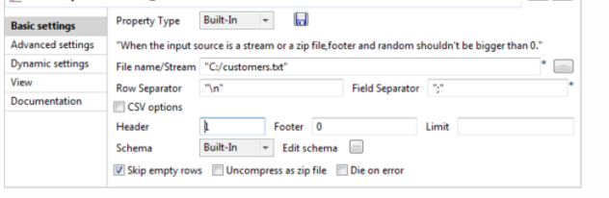
Define the component properties
Double-click the component to open its Basic settings view of tFileInputDelimited
.

Slide 9
Use Contexts and Variables
Variables represent values which change throughout the execution of a program.
Depending on the circumstances the Job is being used in, you might want to manage it differently for various execution types, known as contexts
These parameters are mostly context-sensitive variables which will be added to the list of variables for reuse in the component-specific properties on the Component view through the Ctrl+Space keystrokes.
You can define the values of your context variables when creating them, or load your context parameters dynamically, either explicitly using the tContextLoad component or implicitly using the Implicit Context Load feature, when your Jobs are executed.

Slide 10
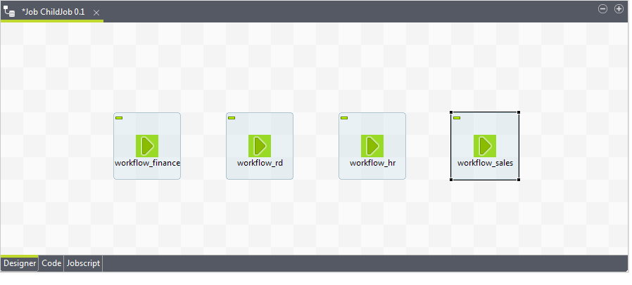
optimize Job performance
Parallelization in terms of Talend Jobs means to accomplish technical processes through parallel executions. When properly designed, a parallelization-enabled technical process can be completed within a shorter time frame.
Parallelization is an advanced feature and requires basic knowledge about a Talend Job such as how to design and execute a Job or a Subjob.
a Job opened in the workspace can contain several Subjobs and you are able to arrange their execution order using the trigger links such as OnSubjobOK.

Slide 11
Questions?
Copyright © 2014 by Vikram Takkar. All Rights Reserved..

